Slide 1
Metabolic Surgery in 2024: Role of Surgery in the Era of Obesity Drugs
Prof. Francesco Rubino
Chair Bariatric and Metabolic Surgery
King’s College London
Consultant (Hon) Surgeon
King’s College Hospital

Slide 2
Disclosures
Research/Educational Grants: Novo Nordisk, Ethicon, Medtronic
Scientific Advisory Board/DSAB: Keyron, Morphic Medical, GT Metabolic Solutions,
Consuklting/Speaking Honoraria: Medtronic, Ethicon, Novo Nordisk, Eli Lilly, Astra Zeneca
Others: President, Metabolic Health Institute (nonprofit)

Slide 3
Will Anti-obesity drugs spell the demise, or the rise of metabolic
surgery ?

Slide 4
Anti-Obesity Drugs will not make surgery obsolete … …but will expedite the ongoing Shift in Focus of surgery (Bariatric >> >>Metabolic Surgery)

Slide 5
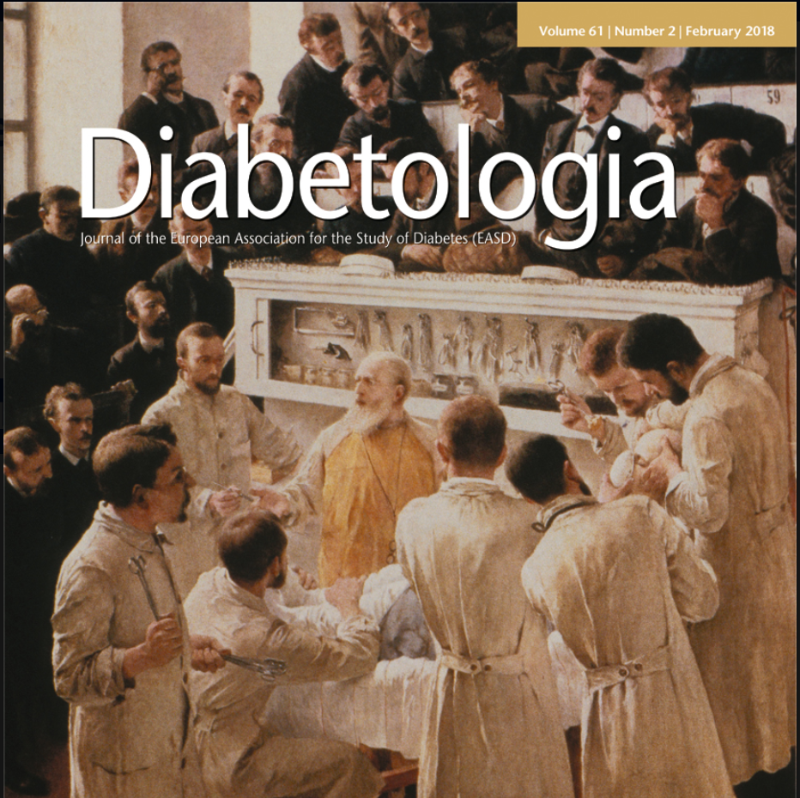
History

Slide 6
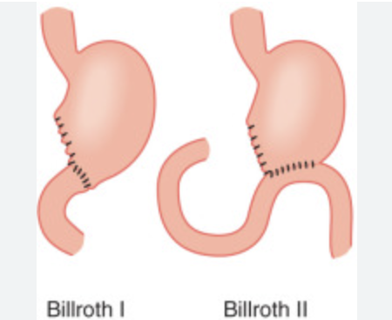
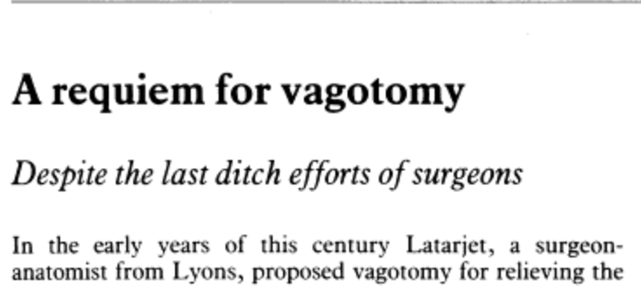
Ulster Med J. 1998
The discovery of H. Pylori opened up the possibility of curing the underlying disease through an eradication regime in 90% of patients
Mid-1970s
H2 receptor
Antagonists (i.e. Cimetidine)
1981
H2-rec
Antagonist Ranitidine
commercialised
1982: Marshall’s
discovery of H. Pylori
1991

Slide 7
Current Anti-Obesity Drugs are not Curative

Slide 8
Pharmacotherapy for CAD : Aspirin, Thienopyridines, Statins, Inhibitors of the renin-angiotensin system, and Beta-blockers
Introduction of CABG for CAD
Discovery of Statins
FDA Approves Aspirin for MI
First PTCA
2024
1960s
1977
1985
“The CABG procedure is the most commonly performed major cardiac operation worldwide”.
1976
almost 400,000procedures performed each year in the USA alone

Slide 9
Unrealistic expectations about efficacy of lifestyle interventions
Which one of the following interventions would be best for someone like you as a treatment for severe obesity (BMI>35kg/m2)? (Select one.)
Diet & Exercise
59%
Drugs (e.g., Ozempic, Wegovy)
14%
Weight-Loss/Bariatric Surgery
14%
Don’t know
Presented at IFSO 2023
The “Emma Study”- manuscript in preparation

Slide 10
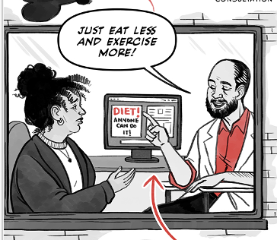
Widespread Assumption that Volitional Control of Weight is Bidirectional, No Matter the Severity of Obesity
Obesity is a condition of excess adiposity
that poses a “risk” to health
Increased Fat Mass/Body Weight

Slide 11
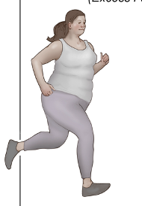
Risk vs Illness
Risk Reduction
(Prophylactic Care)
Risk
Disease treatment
(Therapeutic Intent)
Illness

Slide 12
Risk vs Illness: Patient’s perspective
Risk Reduction
(Prophylactic Care)
Risk
“Let me think about it, I don’t feel ready…”
“Want to try diet one more time”
“Surgery is risky….…”
“Have other priorities right now…”
“Will try medications first…”

Slide 13
Risk vs Illness: Policymakers
Risk Reduction
(Prophylactic Care)
Risk
“Surgery is costly” …
“Return of investmenr”….
“Surgery is dangerous…complications costs….…”
“Have other priorities right now…”
“We will commission more procedures year…”
Mandatory pre-operative weight management…. multi-disciplinary preop assessment…”elective surgery”…

Slide 14
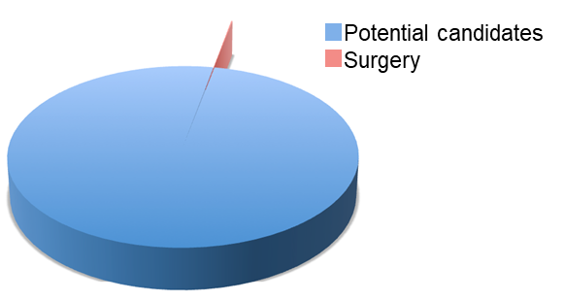
THE IDEA OF OBESITY AS A MODIFIABLE RISK FACTOR SHAPES PERCEPTIONS OF “BARIATRIC” (WEIGHT-LOSS) SURGERY AMONG PATIENTS, REFERRING PHYSICIANS AND PAYORS
Mean worldwide uptake: 0.82%
RISK
ILLNESS
Cost-effectiveness/saving
YEARS/DECADES

Slide 15
The Changing Landscape of (Metabolic) Surgery

Slide 16
Candidates for Traditional ”Weight Loss Surgery”
(Primary and Revisional)
Severe Obesity + ”Co-morbidities”
“Low-Risk” candidates (“must be able to climb at least 2 flights of stairs”)
Young, relatively “healthy”, predominantly female patients

Slide 17
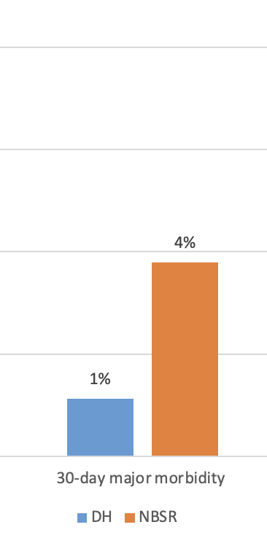
Metabolic Surgery at King’s
Diseases and Conditions in Pts Undergoing Bariatric/Metabolic Surgery at KCH
30-Day Major Complications
National Average
Type 2 Diabetes
Coronary Heart Disease
Heart Failure
NASH
Chronic Kidney Disease
Respiratory disease (Hypoventilation Syndrome)
Patients awaiting other time-sensitive surgery (i.e. transplants, CABG, orthopedic surgery)
Pre- or Post-Liver Transplant
KCH

Slide 18
Prognosis (estimated 10-year survival based on CCI-Score)
10-year survival rates for cancer
(Public Health England 2019)
About 4 in 10 patients on WL have high mortality risk from their disease status (average 10-year survival 36%)

Slide 19
METABOLIC SURGERY
Shift in Focus
RISK
ILLNESS
Cost-effectiveness/saving
MONTHS/YEARS

Slide 20
Lancet Commission on Clinical Obesity
Prof. Francesco Rubino, MD
Commission Chair
View the full report at
https://www.thelancet.com/commissions/clinical-obesity
Rubino et al. The Lancet Diabetes & Endocrinology.
DOI: 10.1016/S2213-8587(24)00316-4.

Slide 21
Early impact
79 Endorsing Organizations
from worldwide
Launch: 16/01/2025
In-person: London, USA, Kuwait
Online attendees: 92 Countries
The Definition of Clinical Obesity is a sharp “before and after moment”
(R. Horton; Editor-in-Chief, The Lancet)
> News/Editorials in many scientific journals
Rubino et al. The Lancet Diabetes & Endocrinology.
DOI: 10.1016/S2213-8587(24)00316-4.

Slide 22
Early impact – In the media
Reports in > 2000 media outlets globally
Rubino et al. The Lancet Diabetes & Endocrinology.
DOI: 10.1016/S2213-8587(24)00316-4.

Slide 23
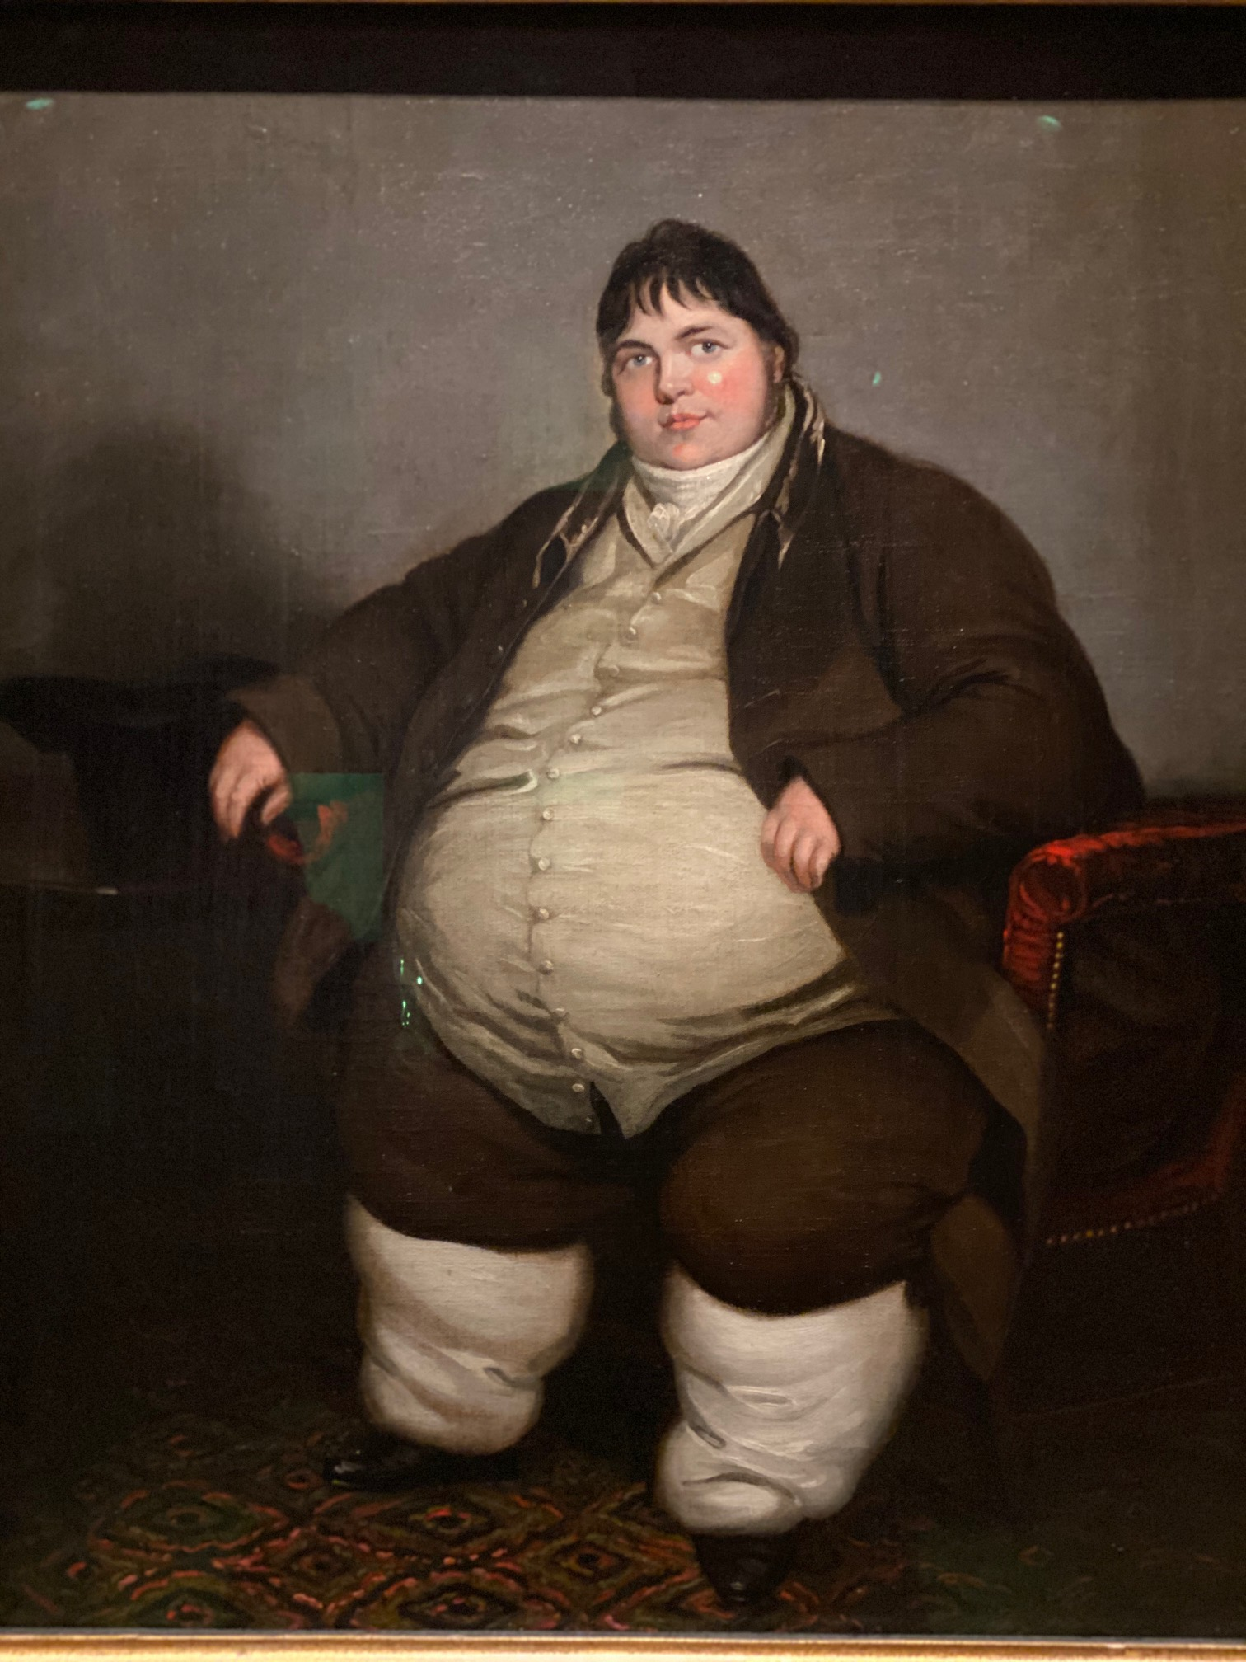
The spectrum of Obesity in medical history
Corpulence, when in an extraordinary degree may be reckoned a disease (M. Flemyng, 1760)
AMA definition of obesity as a disease 2013
WHO 1948
(Obesity as a disease)
Hippocrates
(c. 460 BC – c. 370 BC)
“Corpulence is not only a disease itself, but the harbinger of others”
Obesity is not itself a disease in all instances
(WG. Campbell
1934)
Allison, D.B., et al. Obesity, 16: 1161-1177.

Slide 24
Obesity is a Spectrum (Risk and/or Illness)
Risk Reduction
(Prophylactic Care)
Risk
Blanket definitions
of obesity are not helpful
Disease treatment
(Therapeutic Intent)
Illness

Slide 25
The (crucial) missing piece in the current framing of obesity
- The Illness directly caused by obesity has not been characterized -
Commission on Clinical Obesity

Slide 26
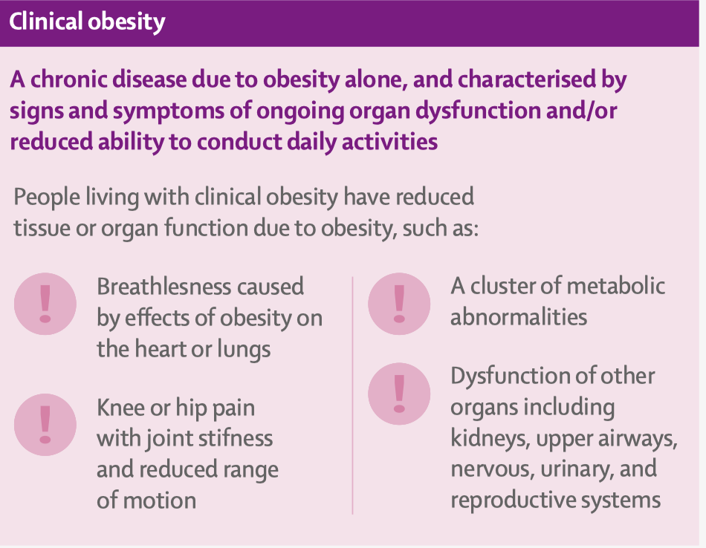
Clinical and Preclinical Obesity

Slide 27
Implications for Care and Policy
Causes of Adipose Tissue Expansion
Obesity
Genetic
Environmental
Psychological
Other (Unknown)
Preclinical Obesity
Clinical Obesity
Primary Prevention
Monitoring +
Prophylactic Intervention
(Risk Reduction)
Therapeutic Intervention
(Corrective Treatment)

Slide 28
N= 627

Slide 29
THE FUTURE OF OBESITY CARE
Metabolic Surgery
Cost-effective/Life saving surgery
RISK
ILLNESS
Lifestyle Int
AOB Meds
Metabolic Surgery +
Adjuvant and Neo-Adjuvant
Meds

